Slide 1
Siya Health®
In medical school, I watched a brilliant, clever friend struggle for years — distracted, restless, unable to finish what he started — before he was finally diagnosed with ADHD. He's now a successful interventional cardiologist. That gap, between clever-but-struggling and diagnosed-and-thriving, is what we built Siya to close.
Physician-led telehealth · care that follows through, before and after the visit · multi-state operations
1 / 16
Notes:
Friend-origin title (consented). Story only on slide 1.

Slide 2
Siya Health®
The problem
The doctor makes the right care plan. The patient doesn't always get to live it.
Care breaks down across three phases — before the visit, during it, and after. Not because of missing technology. Because of missing follow-through.
Pre-visit
At the visit
Post-visit
2 / 16
Notes:
Problem frame — three phases. Detail on slides 3–5.

Slide 3
Siya Health®
Pre-visit
Before the visit, the wrong patients get through — and the right ones don't show up.
· Poor eligibility review → mismatched expectations, refunds, chargebacks, bad reviews
· No personalized reminders → no-shows
Fix
Our concierge team reviews eligibility before booking and calls patients personally to confirm.
3 / 16
Notes:
Pre-visit failure mode + concierge fix.

Slide 4
Siya Health®
At the visit
During the visit, the doctor is doing admin work instead of practicing medicine.
· Incomplete intake → doctor manually gathers history
· No documentation/order support → less patient-facing time
Fix
Our concierge team pre-builds the intake summary and scribes live, so the doctor's time is spent only on the patient.
4 / 16
Notes:
At-the-visit failure mode + concierge fix.

Slide 5
Siya Health®
Post-visit
After the visit, care quietly falls apart.
· Pharmacy coordination failures → prescriptions don't reach the patient
· No structured follow-up → low compliance, interrupted care
Fix
Our concierge team owns pharmacy coordination and structured follow-up — checking in, explaining what to expect, catching problems before they interrupt care.
Today, we've solved this with trained people operating disciplined protocols on top of existing tools. As those protocols mature, they become the blueprint for technology we build ourselves — proven first, encoded second.
5 / 16
Notes:
Post-visit + people-first → technology-later close.

Slide 6
Siya Health®
Traction
Revenue growing steadily since February. Cash-flow positive.
Monthly gross revenue — 2026
60
51
2,700+
1,200+
35
30
27
Patients treated (growing)
Neurocognitive evaluations
23
21
4 states
Cash-flow+
Multi-state operations
Operations
Jan
Feb
Mar
Apr
May
Jun
Jul
Reviews: 4.9★ on Google (100+ reviews) · 4.75★ average across 600+ third-party provider reviews
No-shows: Declining trend Q4 2025–Q1/Q2 2026 as trained MAs and automated reminders took effect — now plateaued, pointing to factors beyond reminders we're actively addressing next.
[Retention: 3-month cohort data pending final team calculation — leave placeholder, do not fabricate]
6 / 16
Notes:
Traction locked 2026-09-01. Retention placeholder intentional.

Slide 7
Siya Health®
Where we are, honestly
We saw the risk before you did — and we're already fixing it.
Proof
Risk
Fix
Founder-led relationships filled every provider's panel, not just the founder's own. It worked — 2,700+ patients prove it.
One person's time doesn't scale. We knew that going in.
September 2026 — a fractional COO joined, already driving fundraising readiness and employer/B2B pipeline. This round adds the clinical capacity to match.
7 / 16
Notes:
Honest risk + fractional COO already in motion.

Slide 8
Siya Health®
Business model
Cash-pay, recurring, no insurance risk.
$149
$79 / mo
$149 / mo
Initial evaluation
Ongoing care — non-controlled
Ongoing care — controlled
One-time, self-pay
Recurring membership
Recurring membership
Siya Health Inc (MSO) + affiliated professional corporation(s) — standard, legally reviewed structure. B2B/employer pricing and MSO management-fee terms are being finalized as the company adds affiliated providers and employer partnerships.
150+ recurring members and growing. Cash-pay means no payer contracts, no reimbursement risk, revenue from day one.
8 / 16
Notes:
Cash-pay model + MSO structure note.

Slide 9
Siya Health®
Market — bottom-up
21.7M working adults live with a diagnosable condition affecting attention, sleep, or focus — most of them undiagnosed or untreated.
Layer
Definition
Size
TAM
US clinical services for adult ADHD + clinical insomnia
~$18B
SAM
Employed adults with either condition, telehealth-willing, cash-pay comparable
~21.7M people
SOM
Year-3, capacity-derived — 8–10 full-time providers at ~800 patients each
~$3.8M–4.8M
Built bottom-up: 163M employed U.S. adults (BLS 2026) · 15.5M diagnosed adult ADHD, 63% employed · ~10% clinical insomnia disorder among employed adults · overlap-adjusted (44% ADHD/insomnia comorbidity, per published clinical data). Existing independent contractor network (8 providers) represents additional capacity not included in this Year-3 estimate. Full sizing methodology available in diligence.
9 / 16
Notes:
Market sizing locked 2026-09-01. ADHD + insomnia bottom-up.

Slide 10
Siya Health®
Competition
Different job. Not a feature checklist.
Employer mental-health platforms (e.g. Lyra Health)
Broad coverage, not built for objective, condition-specific clinical depth
Generic access & counseling (EAPs, episodic telehealth)
Gets you seen once. No structured monitoring, no concierge follow-through
DTC brain-training / wellness apps
Games and self-assessment. Not clinical, no escalation if something real is found
Siya
Clinical-grade screening + a trained concierge team + real escalation to licensed providers, on your schedule, not office hours
No feature matrix. No 'everyone top-right' quadrant.
10 / 16
Notes:
Competition categories — clinical depth + concierge, not feature matrix.

Slide 11
Siya Health®
Go-to-market
Working channels today. Capacity is the job this round funds.
01 · Today
Channels that fill panels
Existing channels + founder-led fill — ~$80 CAC estimate (current channel estimate, not yet a mature/audited figure).
02 · Already in motion
Fractional COO
Fractional COO since Sept 2026 — driving fundraising readiness and B2B pipeline, self-funded.
03 · This round's job
Clinical capacity
Add clinical capacity to serve proven demand.
04 · Timeline
Vendor-delivered CAC
Professional-vendor-driven CAC expected within ~6 months of engaging a partner — no calendar promise.
11 / 16
Notes:
GTM: capacity this round; COO already in motion; no dated Ads CAC.

Slide 12
Siya Health®
Why now
Demand is already here. Healthcare hasn't caught up to what working professionals actually need.
While carefully screening ADHD patients, we noticed something worth building on: a negative ADHD or PTSD screen doesn't mean nothing is there. Healthcare screens for cognitive and mental health reactively — a PHQ flag in Epic, dementia screening starting at 65. We think tracking these markers longitudinally, especially for working professionals under sustained pressure, is worth building now.
Discipline: SOPs, QA, and multi-state compliance already in place — the bottleneck is capacity and founder bandwidth, not the care model.
12 / 16
Notes:
Why now — longitudinal screening insight + capacity bottleneck.

Slide 13
Siya Health®
Use of funds
We're raising $500k to hold capacity and hand off acquisition.
01
Clinical capacity & retention · ~$300k
Two PA/NP hires (licensing, DEA, malpractice, benefits) + medical director multi-state supervision.
02
Leadership capacity · ~$100k
Sustains the fractional COO retainer through the 18–24 month runway, already in motion since September 2026.
03
Professional marketing partnership · ~$100k
Healthcare-specific vendor once capacity is stable.
Objective: Stabilize capacity against proven demand, free founder bandwidth, then replace founder-led acquisition with a professional partner.
13 / 16
Notes:
Use of funds $300k / $100k / $100k — footer language must match slide 15.

Slide 14
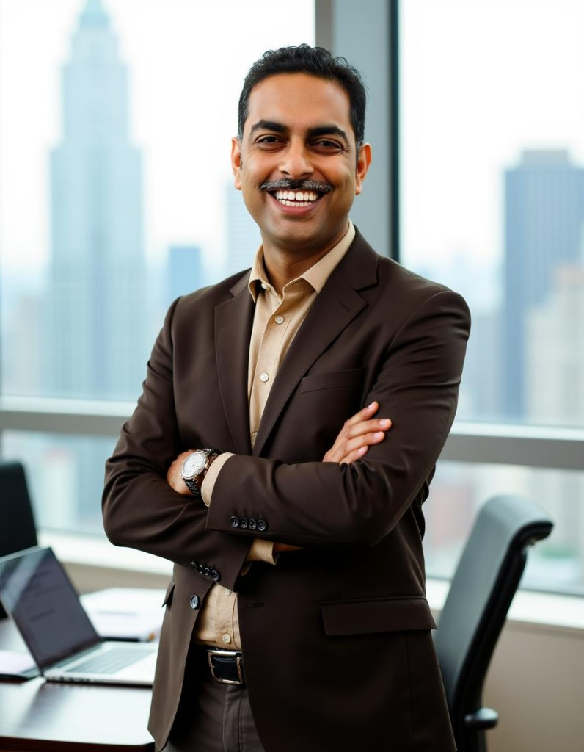

Siya Health®
Founders
Physicians who built the practice before asking for capital.
Dr. Sneh Pandey
Dr. Swati Pandey
Founder · CEO
Co-founder
· Board-certified physician
· 10,000+ patient encounters at Siya Health across primary care, obesity, hospital medicine, and ADHD care
· Built multi-state practice to 2,700+ patients, cash-flow positive, bootstrapped
· Board-certified physician, licensed in Pennsylvania
· Co-founder and clinical advisor — shapes clinical protocol standards across Siya Health
I was strict about controlled substances in my own training, long before Siya existed. I'd read about companies getting sued for overprescribing, and I didn't want us to become another cautionary tale. So the pill counts, the random drug screens, the compliance formalities — none of that came from a regulation checklist. It came from not wanting my name attached to a company that cut corners on this.
— Dr. Sneh Pandey
14 / 16
Notes:
Founders + compliance pull-quote under Sneh. Friend story stays on slide 1 only.

Slide 15
Siya Health®
Years spent learning how to deliver better care. This round scales what already works.
Seed round
$500,000
Clinical capacity & retention · Leadership capacity · Professional marketing partnership
15 / 16
Notes:
Ask footer must match Use of Funds category labels exactly.

Slide 16
Siya Health®
Let's talk.
Dr. Sneh Pandey · Founder & CEO
chiefservant@siya.health
siya.health
16 / 16
Notes:
OpenVC: CEO direct email.

